Slide 1
Mid Term Competition
Group: Pytticelle
Aiello Simone 242469
Crudo Giovambattista 249843
Dramisino Cristian Domenico 247961
Tassone Gabriele 249859

Slide 2
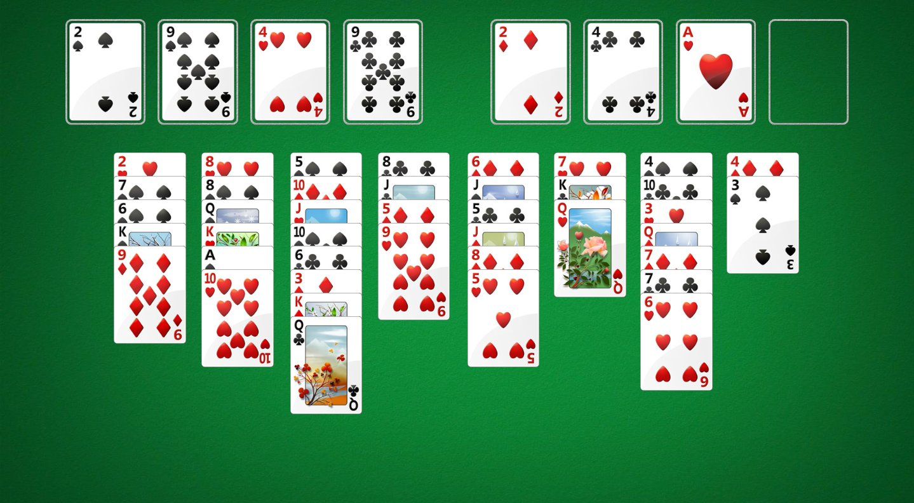
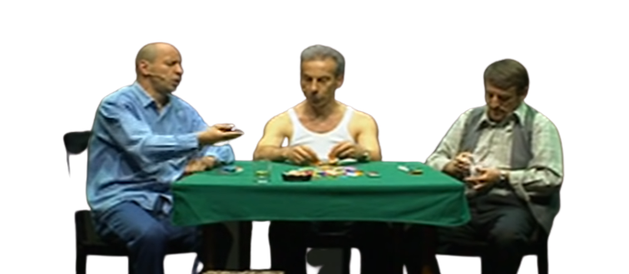
Environment
Environment Description
Example of a FreeCell game.
Deterministic
Fully Observable
Single Agent
Static
Discrete

Slide 3
Our initial approach
We started writing the possible actions in PDDL.
We found 10 suitable actions to be implemented.
3 of them are basic card movements.
2 of them are ways to send cards from column to home.
2 of them are ways to send card from column to free cell.
3 are ways to send cards from freecell to column/home.
We also implemented 2 macro actions in order to move 2 or 3 cards in the same action, depending on specific conditions(e.g. the number of free cells).

Slide 4
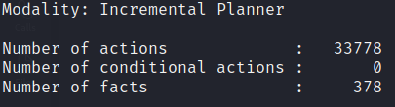
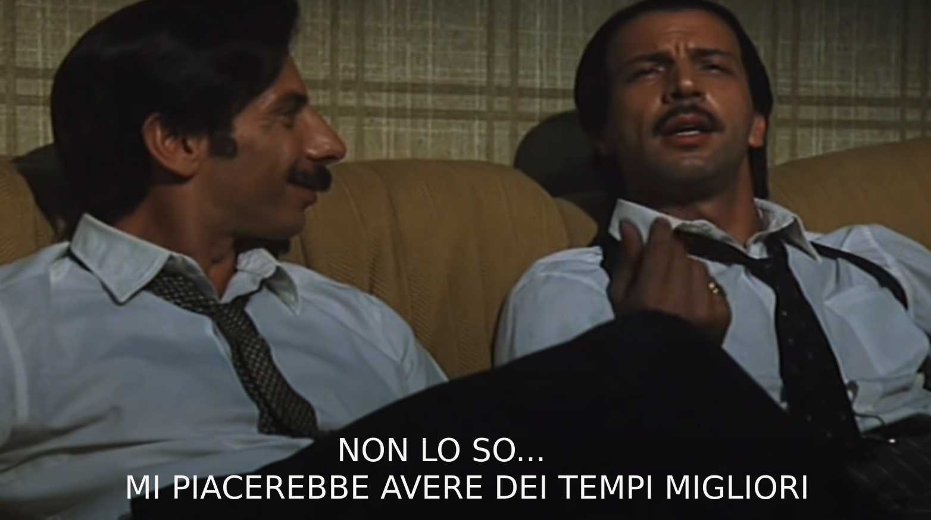
Results after the initial approach
First conclusions and evaluations.
Initial Search Space
We found out that the initial search space was too big to explore in a fast way.
For a classic game of FreeCell consisting of all the 52 cards, the plan takes on average ~90 seconds to be elaborated.

Slide 5
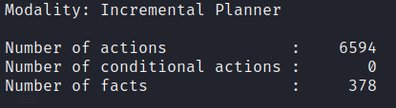
Second and final approach
Second Approach
Resulting Search Space
Running our solution againts the given problems we found out that some of the implemented moves were never used.
We then decided to remove those actions since they can be simulated by other «atomical» actions (or they are never used by the planner), cutting down the number of implemented actions from 12 to 7.

Slide 6
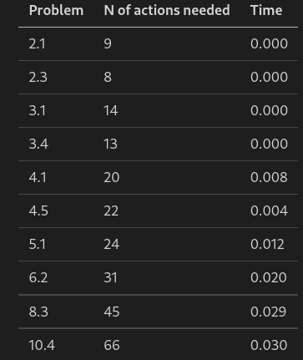

Final evaluation
Conclusions
Timings (based on editor.planning.domains)
Based on the previous observations we decided to create two domain files
The first one contains all the possible actions, which is useful if you want a solution with the less amount of actions made possible.
The second one instead is the “fastest” one since it needs to explore a smaller search space.

Slide 7
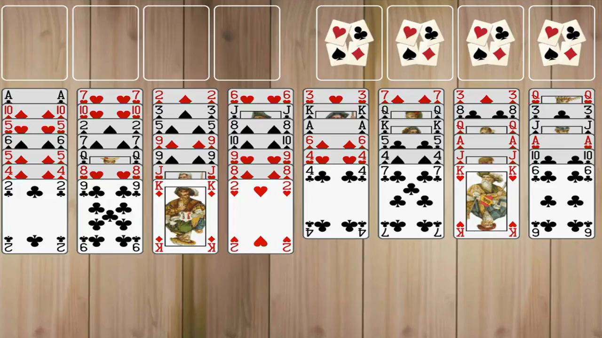
Enjoy the final result

